Slide 1
Software Engineering and Architecture
Networking in Java:
Sockets

Slide 2
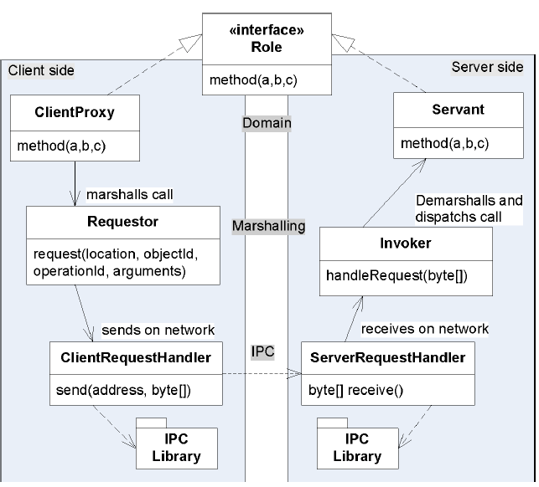
Getting Data over Network
The IPC needs to
transmit/receive
data over the
network
InterProcess-
Communication

Slide 3
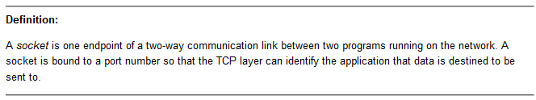
Networking from Code
The most fundamental abstraction of network is the Socket
So, your computer has an IP address, and you then create a Socket with a specific port number
  And you have something you can address from a client

Slide 4
The Socket Abstraction
Once a socket is established you can get an input- and output stream
That is, you can read and write to the stream, just as you would read and write to a File!

Slide 5
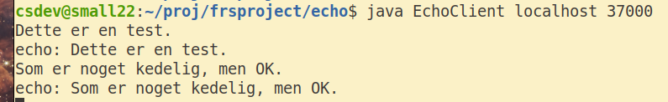
Example from Java Tutorial
The Echo Server
  Just returns anything you send to it (Booooring...)
Start the server on port 37000
And a client
Notes:
META: In FRSProject/echo

Slide 6
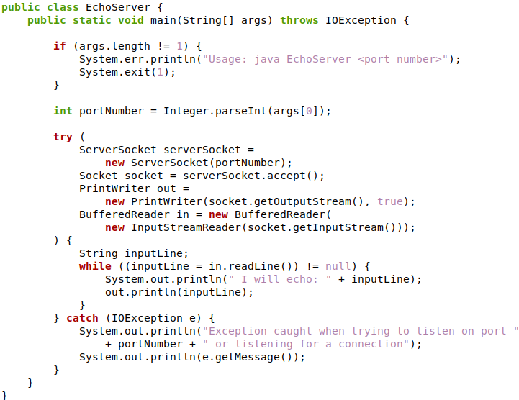
Echo
Echo Server
  ServerSocket
  accepts, and…
  Returns a
  Socket
  With the in/out
  streams

Slide 7
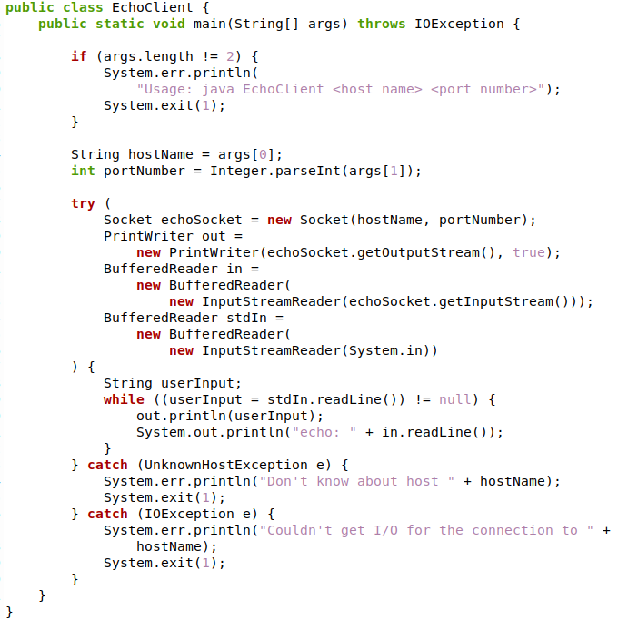
Echo
Echo Client
  The client creates
  the Socket directly

Slide 8
Exercise
Now, you have enough to build Fortnite or LoL ☺
  Tack a bit of graphics on...
Almost...
  Quality Attributes needed
    Security
    Performance
    Availability
    Modifiability – the programming model is terrible lowlevel
  The reason we will do Broker
    Architectural Pattern to address the programming model…

